Slide 1
Web mobile Platform team at Mobile.de
Notes:
Source: mobile.de Case Study
https://www.kanban.university/#resources

Slide 2
Kanban board at Tupalo IT
Notes:
Source: Tupalo Case Study
https://www.kanban.university/#resources

Slide 3
Tupalo Marketing an Communications Board

Slide 4
Magnets, colored paper tickets, markers and avatars at Tupalo
Notes:
Source: Tupalo Case Study
https://www.kanban.university/#resources
The magnets, colored paper tickets, markers and avatars that Tupalo used on their Kanban boards.

Slide 5
Basic IT Operations Board, Kanbanize
Notes:
Source: Kanbanize.com

Slide 6
Marketing Agency’s Kanban Board – multiple clients

Slide 7
SwiftKanban board with User WIPs

Slide 8
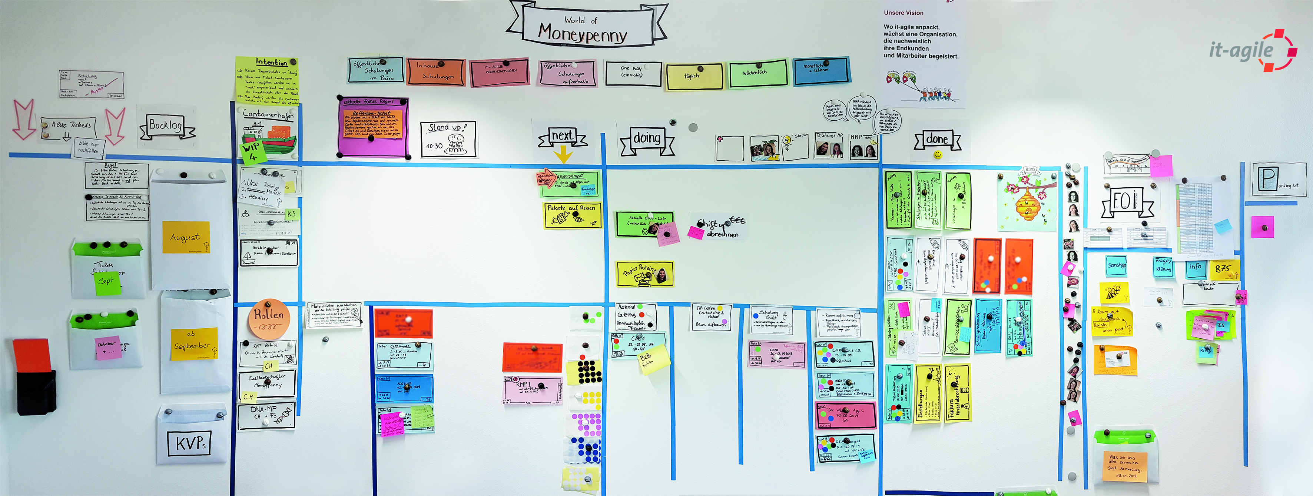
Moneypennies @ it-agile
Notes:
See the separate PDF with details.

Slide 9
“Kanbanraum” at Visotech
Notes:
Source: Visotech Case Study

Slide 10
Gathering throughput data at Visotech
Tubes with balls in colors corresponding to each department. Each ball indicates two hours labor. KVP stands for continuous improvement and is part of the red segment, which indicates internal work. Other groups of tubes are split in Projects and Client Support. The tubes provide a quick and clear view of each department’s effort in each category.
Notes:
Zoom-in on the prior image.

Slide 11
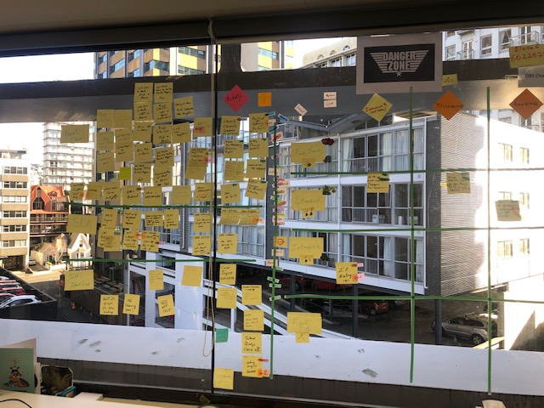
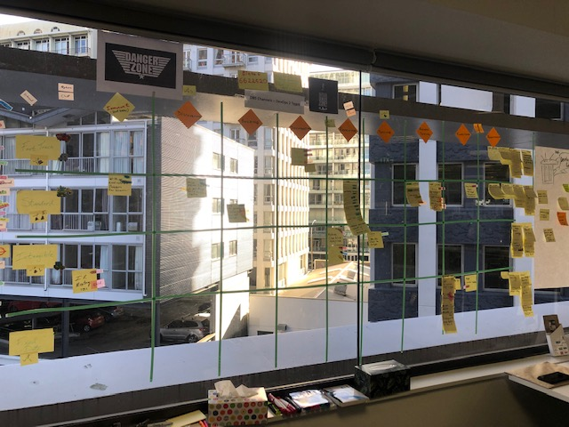
DevOps Team at Stats
Notes:
Zoom-in on the prior image.

Slide 12
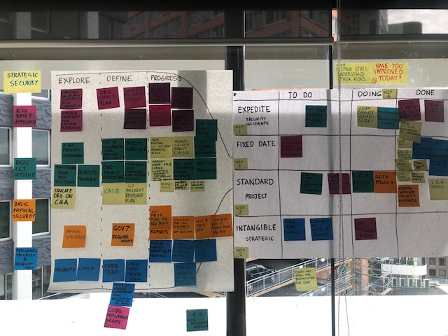
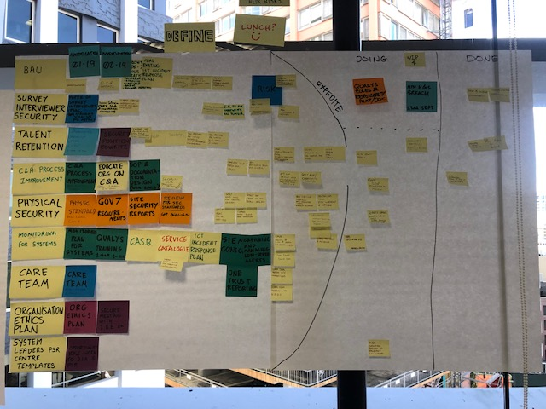
DevOps Team at Stats
Notes:
Zoom-in on the prior image.

Slide 13
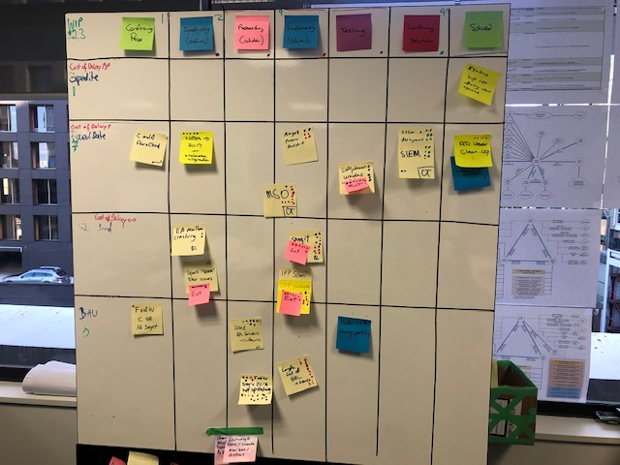
DevOps Team at Stats
Notes:
Zoom-in on the prior image.

Slide 14
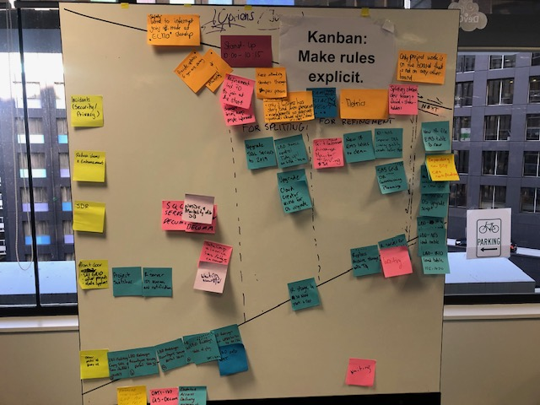
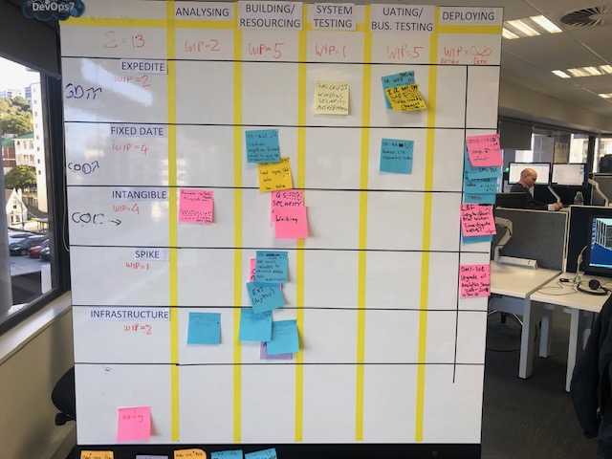
DevOps Team at Stats
Notes:
Zoom-in on the prior image.

Slide 15
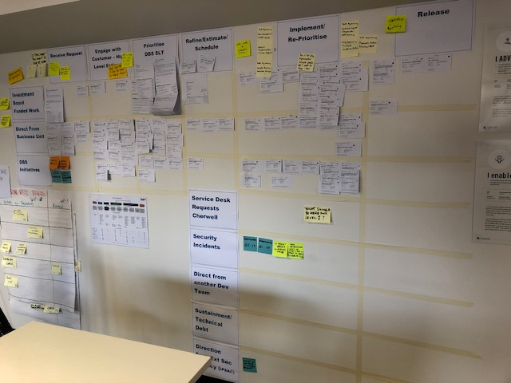
DevOps Team at Stats
Notes:
Zoom-in on the prior image.

